Slide 1
Cooperation Systems – Final presentation Visual augmented reality manual support
A. Droste, A. Machmer, A. Mantel, J. Schwede
Department for computer science
7th of February 2019

Slide 2
Our cooperation system (1/3) – idea
AR support for the collaborative usage of (operation) manuals
e.g. build your furniture together with additional complementary information
Supporting through Augmented Reality
Different roles possible but not necessary
“Searcher”
“Builder”

Slide 3
Our cooperation system (2/3) – goals

Slide 4
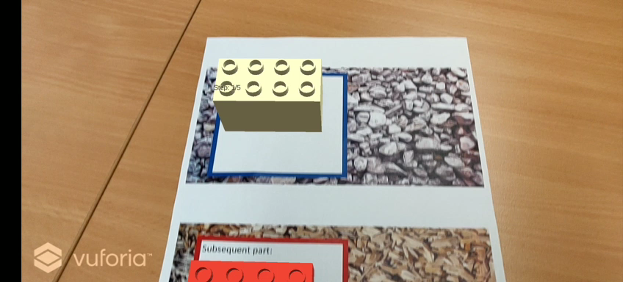
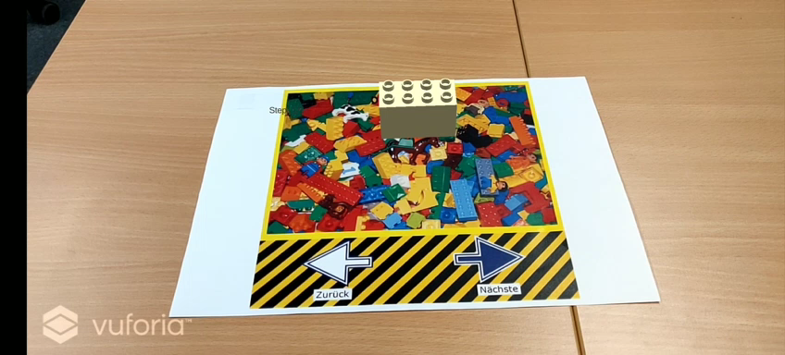

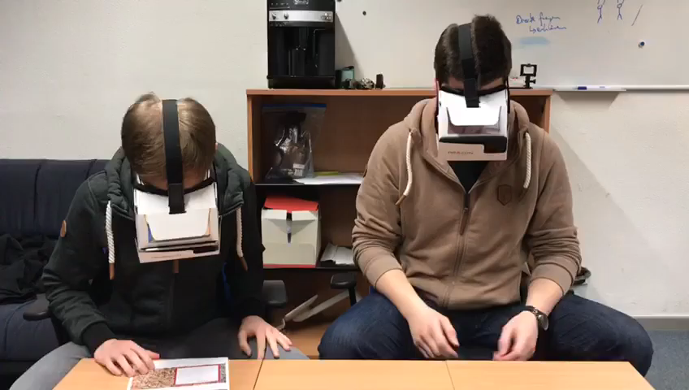
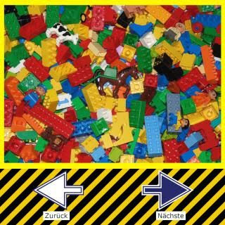

Our cooperation system (3/3) – prototype
Marker for searcher (show next parts)
Marker for builder (show steps to assemble)

Slide 5
Concepts for this cooperation system
Social interaction and coordination tool
properties of parts in list of next parts
Roomware
Awareness
All parties are always aware of the progress and the actual following task
transparency of bricks in modell to show progress
Synchronous bidirectional communication support
Co-located (AR shared space)
In general a symmetric system design (Exploring, working on the same content, build/assemble the furniture together (teamwork))
Can also be used in an asymmetric scenario (Helper-Expert)

Slide 6
Evaluation
user studies
Questionnaires (pre/post)
Time measurement
Kirkpatrick Model
Reaction – Do the users need this support?
Learning – Can users work better together to build their furniture?
(Transfer) – Can they use the knowledge with different manuals?
(Results)

Slide 7
Evaluationresults (1/2)
tmp

Slide 8
Evaluationresults (2/2) – time measurement
Experiment Group | Time without visual support through AR | Number of mistakes and questions | Time with visual support through AR | Number of mistakes and questions

